Slide 1
Module 2
Mgmt 6062 - Project Risk and Quality

Slide 2
Module agenda
PMBOK Risk Management Overview
What you need before you can effectively begin risk management
What are companies doing for risk management?
Planning risk management
Risk management group project
Homework

Slide 3
From last week
Project risk: An __________ event or condition that, if it occurs, has a _________ or ________ effect on one or more project objects such as scope, schedule, cost and quality.
A risk can be a threat or a(n) __________.
A fact is/is not a risk.

Slide 4
From last week
Project risk: An uncertain event or condition that, if it occurs, has a positive or negative effect on one or more project objects such as scope, schedule, cost and quality.
A risk can be a threat or an opportunity.
A fact is not a risk.

Slide 5
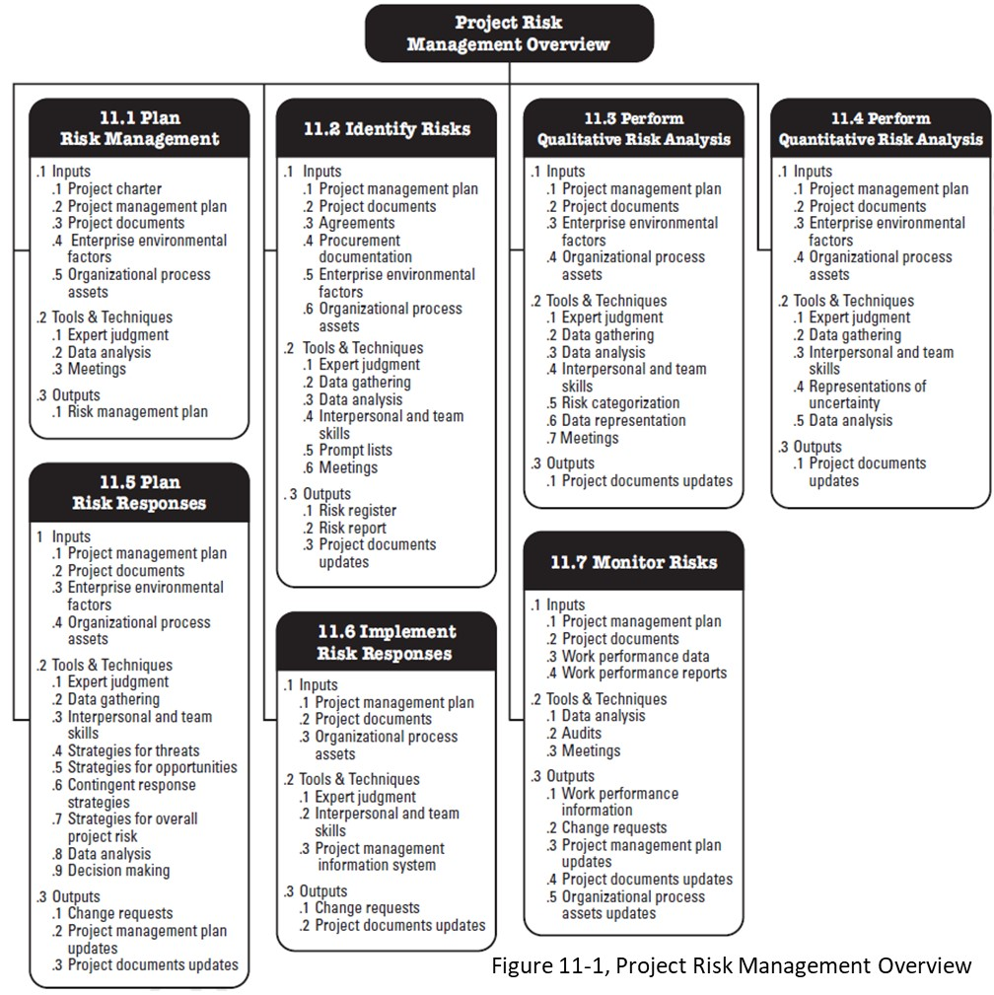
PMBOK
Seven processes
How do they interact?

Slide 6
Risk management process
11.1 Plan Risk Mgt
Develop Risk Register
11.3 Qualitative Risk Analysis
11.4 Quantitative Risk Analysis
11.5 Plan Risk Responses
11.6 Implement Risk Responses
11.7 Monitor Risks
11.2 Identify Risks

Slide 7

Risk management process
11.1 Plan Risk Mgt
Develop Risk Register
11.3 Qualitative Risk Analysis
11.4 Quantitative Risk Analysis
11.5 Plan Risk Responses
11.6 Implement Risk Responses
11.7 Monitor Risks
11.2 Identify Risks
IMPORTANT: Iterative process throughout the entire project life cycle

Slide 8
What You Need Before You Can Effectively Begin Risk Management
Certain things must be done before you can adequately complete risk management.
Effective risk management must occur within a properly executed project management process.
Without the necessary inputs, some risks will remain unidentified.

Slide 9
Inputs
All the inputs we need for Risk Management as identified in the PMBOK.
Many inputs are repeated across the risk management steps. Example: organizational process assets.

Slide 10
Why are these inputs required?
As an individual, pick 2 or 3 of these items, determine when/why these inputs are required for these PMBOK processes in risk management; find or create an example. Alternatively, if groups are used, each group can work on one area:
1.1 Plan Risk Management
Project Charter
Stakeholder register (Project Doc)
11.2 Identify Risks
Agreements
Procurement documentation
11.3 Perform Qualitative Risk Analysis
Assumptions log (Project Doc)
Risk register (Project Document)
11.4 Perform Quantitative Risk Analysis
Risk Mgmt Plan (Project Mgmt Plan)
Milestone list (Project Document)
11.5 Plan Risk Responses
Project team assignments (Project Doc)
Resource calendars (Project Doc)
11.6 Implement Risk Responses
Lesson learned register (Project Doc)
Risk report (Project Doc)
11.7 Monitor Risks
Work performance data
Work performance reports

Slide 11
What are organizations doing for risk management
In groups of 2 or as an individual:
Research online or watch the video provided, as this pertains to the individual assignment. The Adelaide underpass.
For the coming weeks, we will identify the risks and opportunities
Measure the appetites of risk and opportunities
By doing a qualitative or quantitave analysis
Applying responses
Monitor and control the risk strategy

Slide 12
Plan Risk Management

Slide 13

Risk management process
11.1 Plan Risk Mgt
Develop Risk Register
11.3 Qualitative Risk Analysis
11.4 Quantitative Risk Analysis
11.5 Plan Risk Responses
11.6 Implement Risk Responses
11.7 Monitor Risks
11.2 Identify Risks
Sets the tone for the rest of the risk management process.
Decides: how to proceed, who should be involved, timing of risk management activities and frequency, overall effort (budget) related to risk management.
BEFORE even identifying project-specific risks

Slide 14

Plan Risk Management a closer look at Ittos
All 18 components – see page 89 of PMBOK
Includes stakeholder register
Includes stakeholder analysis
PMBOK tools and techniques are summarized in PMBOK Appendix X6

Slide 15
Objectives of the plan risk management process
Create a plan for handling risk management (not the individual risks at this point….but risk management in general)
Adapt policies and procedures for risk to the needs of the project
Tailor risk management activities to the needs of the project (the PMBOK is NOT customized for all organizations and projects)
Determine how you will measure the success of your risk management efforts. Use metrics such as how many unidentified risks occurred, risk owners not begin prepared, extra reserve requested, number of fallback plans that needed to be implemented.

Slide 16
Who should be involved in planning risk management?
The Project Management Office (PMO) – provides organizational process assets and other inputs; may have generic approach to start with
Risk Management Department
Finance
Governance body
Risk team
Some stakeholders

Slide 17
Risk management plan
The risk management plan is developed BEFORE identifying project-specific risks
The risk management plan includes:
Methodology
Roles and responsibilities
Budget for risk management activities
Timing
Definitions of probability and impact
Stakeholder tolerances
Reporting formats
Tracking

Slide 18
Risk management group project (and M6 assignment)
M6 Risk Register (Individual)
Risk Management Project (Group)
Expand
Group project submission consists of a risk management plan and risk register. Your professor will provide the topic for the project and provide direction on creating groups.

Slide 19
Homework and evaluations
Upcoming M3 readings per Course at a Glance summary (i.e., readings from Kerzner, PMBOK, Newton)
Assignments and quizzes, check the Course at a Glance and FOL/Content/Course Assignments & FOL/Evaluations/Quizzes

